Slide 1
Predicting Outcomes of NFL Contests
Springboard Capstone 1
Mike Ries

Slide 2
Problem Statement
Mathematical approach to predicting NFL over/unders
Predict total points scored in any NFL game
Identify value in the betting/fantasy football markets

Slide 3
Attributes
Each team’s offensive matchups, overall matchups
pff grades
Points per game, opponent’s ppg. allowed
venue data
Home/Away
Sportsbook totals

Slide 4
Data Collection
Built web scrapers using bs4
Pro-football-reference.com
Profootballfocus.com
Footballoutsiders.com
Using data from 2006 onward
All data put into .csv files and loaded into pandas dataframes

Slide 5
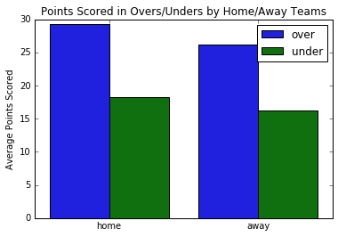
Preliminary Insights
1350 games went over, 1341 went under, 45 pushed
In “over” games, the average score is 55.5 points
In “under” games, the average score is 34.4 points
Value for fantasy players
High total games average 51.5 points
Low total games hit “over” at 55.7%
Under hits at 63% when away team faces elite coverage

Slide 6
Inferential Statistics
Highest correlations to points scored for both H/A teams:
ptsMatchup
totalDvoaMatchup
offMatchup
passMatchp
ovrMatchup
All these correlations are between .23 and .30
Some dependent variables are highly correlated, but none exceed .77

Slide 7
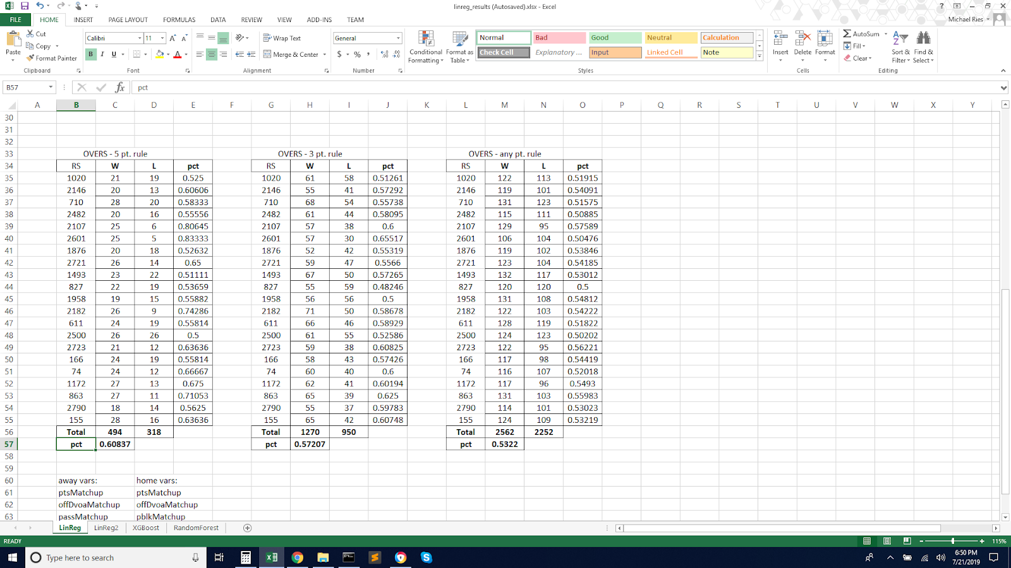
Machine Learning
Tried Multiple linear regression, random forests, XGBoost
MLR performed best
5-point overs rule has a 60.8% win rate
Roughly one recommendation per week
8.4% ROI using this system

Slide 8
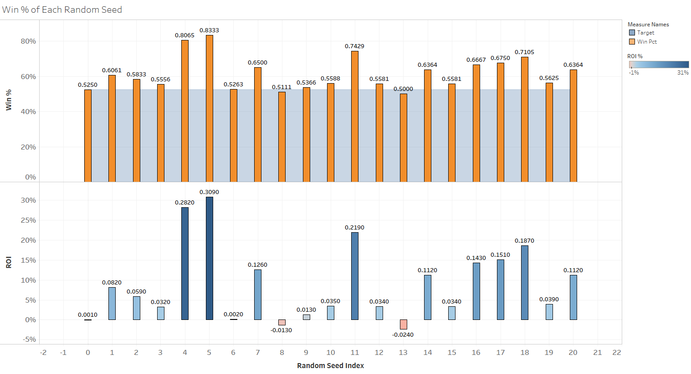
ROI

Slide 9
Next steps/Future Work
Collect and implement additional data into models
In-game statistics, such as pass yards per game
Try additional algorithms
Pitch results to clients, friends, sportsbooks

